Slide 1
Introduction to Programming
Session 02
Problem Solving

Slide 2
Objectives
Problem solving
Introduction to Algorithms
Flowchart
Practice

Slide 3

Problem solving

Slide 4
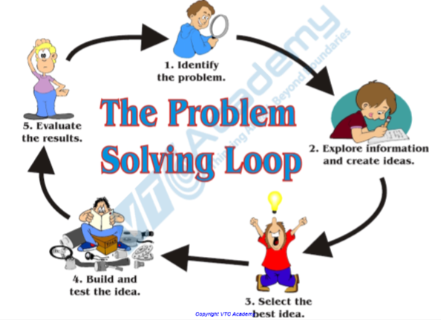
Problem solving

Slide 5
Problem solving
Not simply programming
Complex, including many stages of development
Important stages
  Step 1. Determine problem requirements
  Step 2. Analyze and design the problem
    Select solution (algorithm)
    Algorithm construction
  Step 3. Programming
  Step 4. Test and adjust the program
  Step 5. Deployment and maintenance

Slide 6
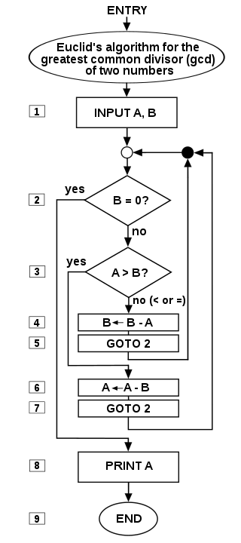
Algorithms
An algorithm, also known as an algorithm, is a finite set of rules or sequences of strict rules of instructions or a sequence of operations to solve a problem and provide a result (output) from a set of input data (input).

Slide 7
Algorithms
An algorithm must ensure the properties:
  Accuracy: to ensure the calculation results or operations performed by the computer are accurate.
  Transparency: The algorithm must be expressed by transparent statements; The statements are arranged in a certain order.
  Objectivity: An algorithm, although written by many people on many computers, still has to produce the same result.
  Universality: An algorithm not only applies to a certain problem, but also to a class of problems with similar inputs.
  End calculation: The algorithm must consist of a finite number of calculation steps.

Slide 8
Describe an algorithm
Method 1: Natural language
Method 2: Languages flowchart (flowchart diagram)
Method 3: Pseudocode is called a PDL (Programming Description Language) programming language.
Method 4: Programming languages like Pascal, C / C ++ or Java. However, it is not necessary to use the proper notation of those languages, which can remove some constraints.

Slide 9
Natural language
For example, the algorithm to solve the first order P (x): ax + b = c, (a, b, c are real numbers), the algorithm represents in natural language as follows:
If a = 0
  b = c, then P (x) has any solution
  b ≠ c then P (c) has no solution
If a ≠ 0
  P (x) has only one solution x = (c - b) / a

Slide 10
Natural language
Use a natural language to list the steps of the algorithm
Advantages
  Simple
  Does not require writers and readers to have a basic knowledge
Defect
  Lengthy
  Does not highlight the structure of the algorithm
  Difficult to perform with complex math problems

Slide 11
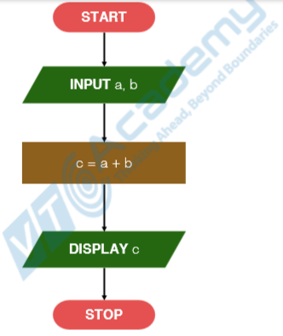
Flowchart
A flowchart is a type of diagram that represents a workflow or process. A flowchart can also be defined as a diagrammatic representation of an algorithm, a step-by-step approach to solving a task.

Slide 12
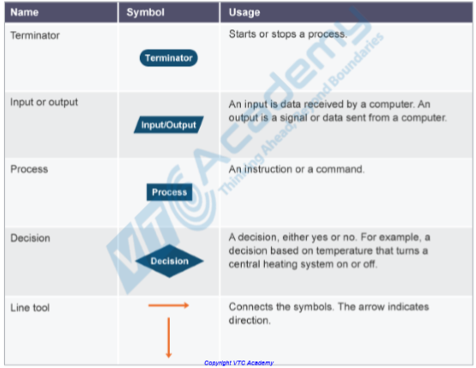
Flowchart symbols

Slide 13
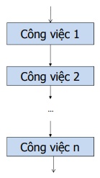
Sequence Construct
The steps are done in a linear sequence, one step after another

Slide 14
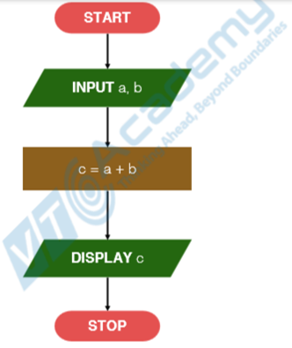
Sequence Construct
Example: input and display sum of two numbers

Slide 15
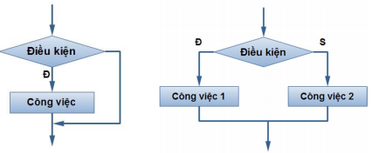
If Construct
If the conditional expression is true (the truth value is True) perform job 1.
If the conditional expression is false (the truth value is False) does job 2.

Slide 16
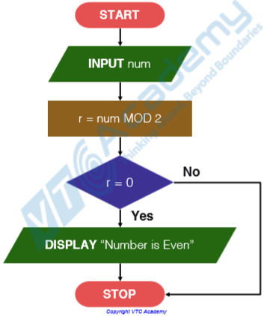
If Construct
Example 1: input a number and check if it is an even number.

Slide 17
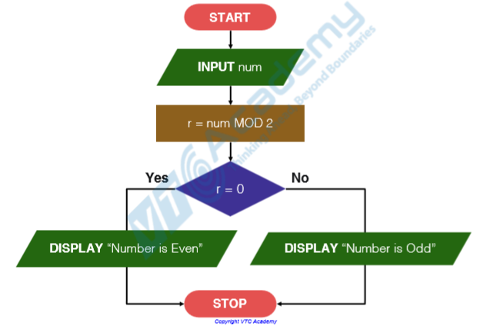
If Construct
Example 2: input a number and check if it is an even or a odd number.

Slide 18
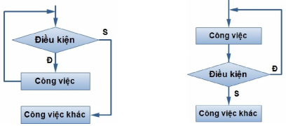
Loop Construct
When the expression is still true, executing the job (check the condition first)
Executing the job when the expression is still true (check the condition after )

Slide 19
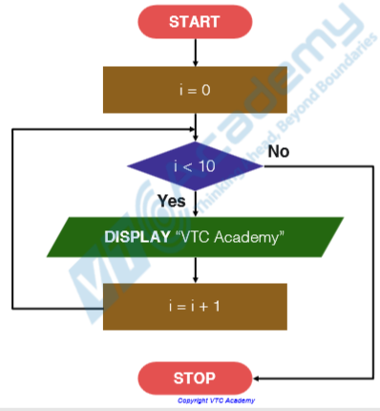
Loop Construct
Example: display to the screen with 10 lines “VTC Academy”

Slide 20
Flowchart
Advantages
  Intuitive, easy to understand, easy to design
  Provides overview, algorithm overview
Defect
  Bulky
  Difficult to perform with complex problems

Slide 21
Examples
Problem: Make conclusions about the correlation of two numbers a and b (>, <or =).
Input: Two numbers a and b
Output: Conclusion a> b or a <b or a = b.
Algorithm:
  S1: Enter the number a and number b.
  S2: If a> b, display "a> b". Finish, Reverse to S3.
  S3: If a = b, display "a = b". Finish, on the contrary, display "a <b".
  S4: Finish

Slide 22
Examples
Problem: Find the maximum value of an integer sequence of N numbers
Input: positive integers N and N integers a1, a2, ..., aN
Output: largest integer of the range
Idea:
  Initialize value Max = a1
  Compare Max with anyone in turn with i = 2,3, ..., N;
    if ai > Max we assign ai new value to Max
Algorithm:
  S1: Enter n and the sequence number a0, a1, a2, ..., an-1.
  S2: Max = a0; i = 1 (index of the next element).
  S3: If i <= n-1, go to S4, otherwise print the Max value. End.
  S4: If ai> Max, Max = ai
  S5: Increase i = i+ 1. Jump to S3.
  S6: Finish.

Slide 23
Examples
Prime number problem: Given a positive integer p. How do you know if p is a prime number or not?
Input: p is positive integers
Output: the conclusion about the prime of p
Idea:
  p = 0 or 1? => Not a prime number
  p> 1?
  Checks from 2 to p-1 is a divisor of p
  If yes then conclude p is not prime, otherwise there is no prime then conclude p is prime

Slide 24
Examples
The problem of Finding greatest common divisor and least common multiple of two numbers.
Input: 2 integers a & b
Output: UCLN, BCNN results of a & b
Idea
  S1: Enter 2 numbers a, b
  S2: x = a, y = b
  S3: If y ≠ 0, go to S4, Conversely, UCLN = x, BCNN = (a * b) / UCLN. Showing UCLN, BCNN. End
  S4:
    r = (x mod y)
    x = y
    y = r
    Back to S3.

Slide 25
Exercises
Problem 1: Find all divisors of a positive integer N
Problem 2: Find all odd divisors of a positive integer N
Problem 3: Check the perfection of positive integers N.
Problem 4: Show all perfect numbers in paragraph [1,10000].
Problem 5: Find the N Fibonacci number

Slide 26
References
https://en.wikipedia.org/wiki/Algorithm
https://en.wikipedia.org/wiki/Flowchart
https://10tin2k11.clan.su/news/thu_t_toan_va_cach_bieu_di_n_thu_t_toan/2011-08-19-19
https://www.geeksforgeeks.org/fundamentals-of-algorithms/

Slide 27


